Slide 1
Riffing on Surface
Andy Wilson & Hrvoje Benko Microsoft Research
UCSB Talk - March 6th, 2009

Slide 2
Overview
Surface-like stuff (Andy)
PlayAnywhere
LaserTouch
Pinching
TouchLight (maybe)
Devices on the table (Andy)
Work by Alex
New Form Factors (Benko)
4x6
Sphere
Dome
Surface Physics (Andy)
ShapeTouch (maybe)
DepthCam Interactions (Andy) (maybe)
MicroMotoCross
BeachBall
DepthTouch
pptPlex + 3DV

Slide 3
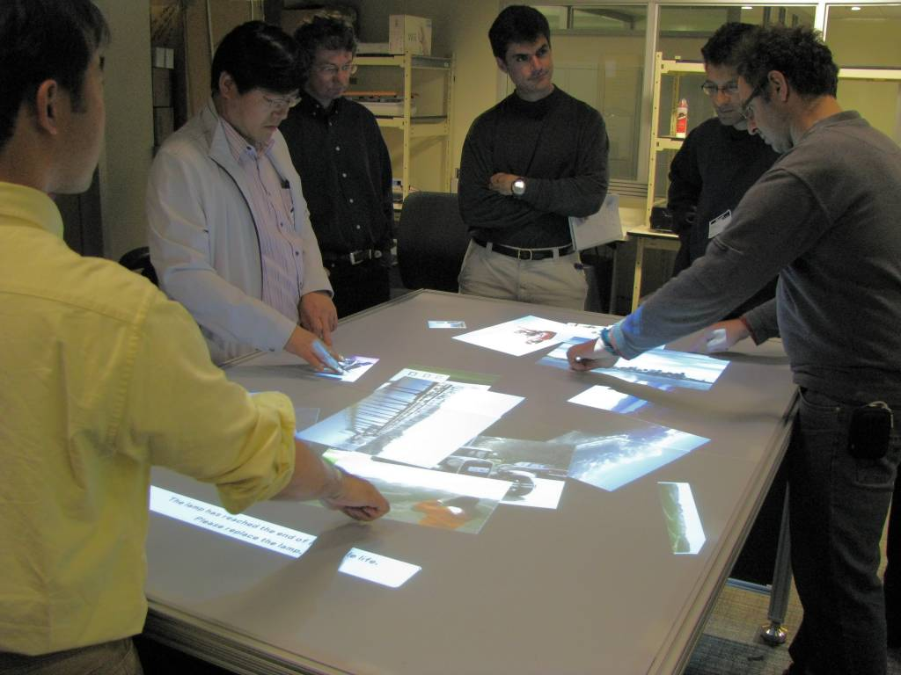
FourBySix: Integrating Digital and Physical Worlds
Bjoern Hartmann
Hrvoje Benko
Merrie Morris
Andy Wilson

Slide 4
Facilitating Design Brainstorming
Multiple designers (no master user)
Enable rapid capture, retrieval, annotation, and collection of visual material
Easy transition between physical and digital mediums
Work with found, drawn, and captured imagery
Organize images into functional collections
Record meeting histories

Slide 6
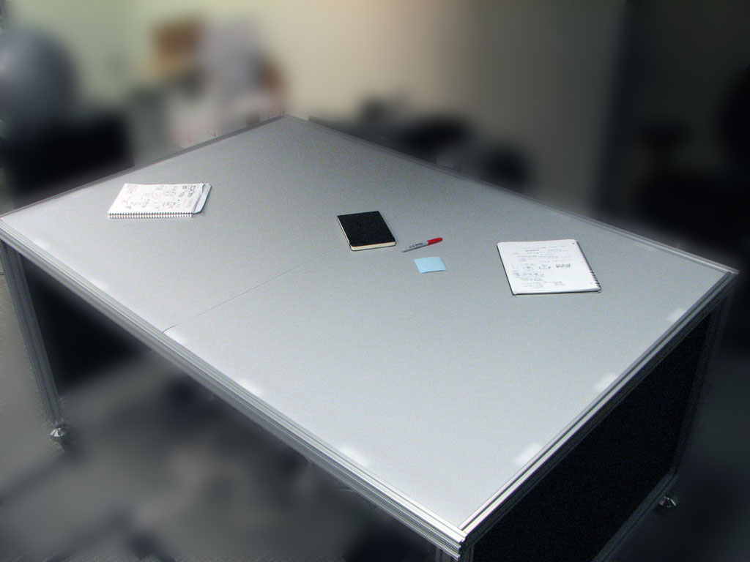

Slide 7
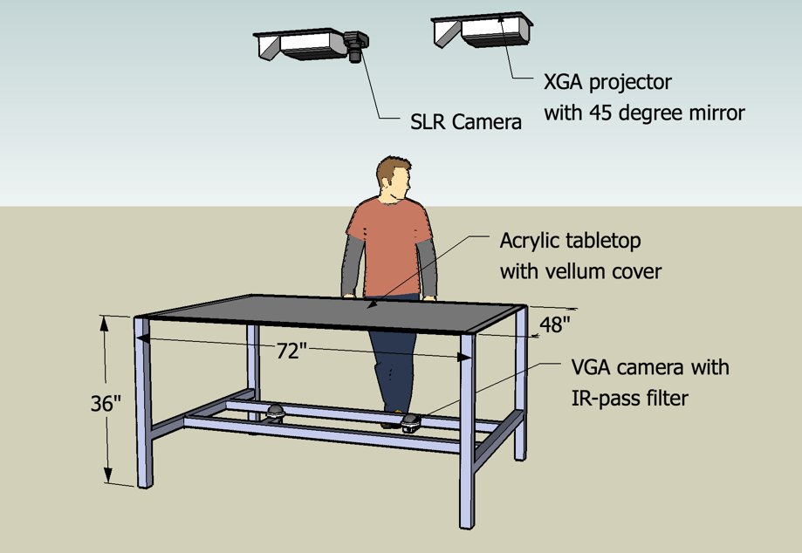
Hardware
Total cost: ~$6000

Slide 8
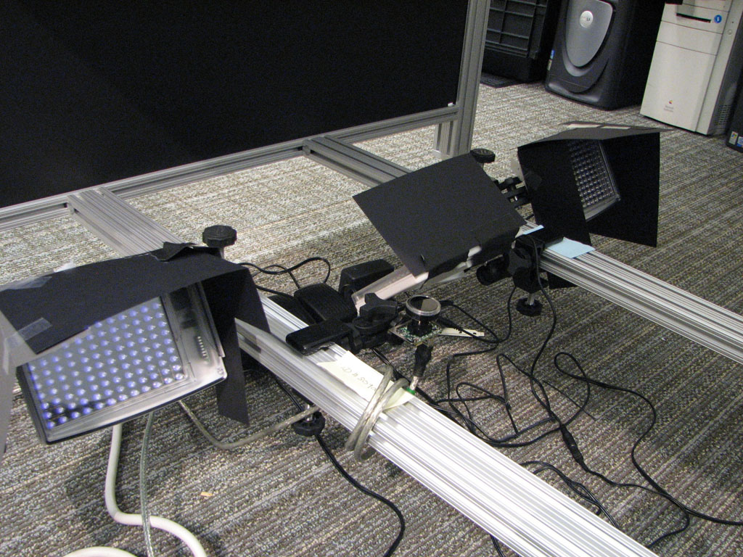
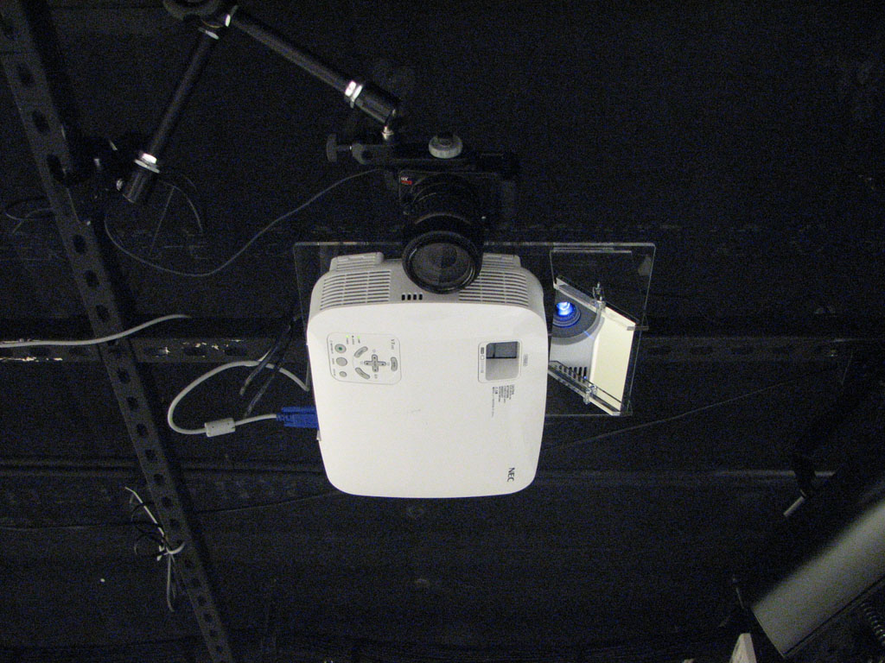

Slide 9
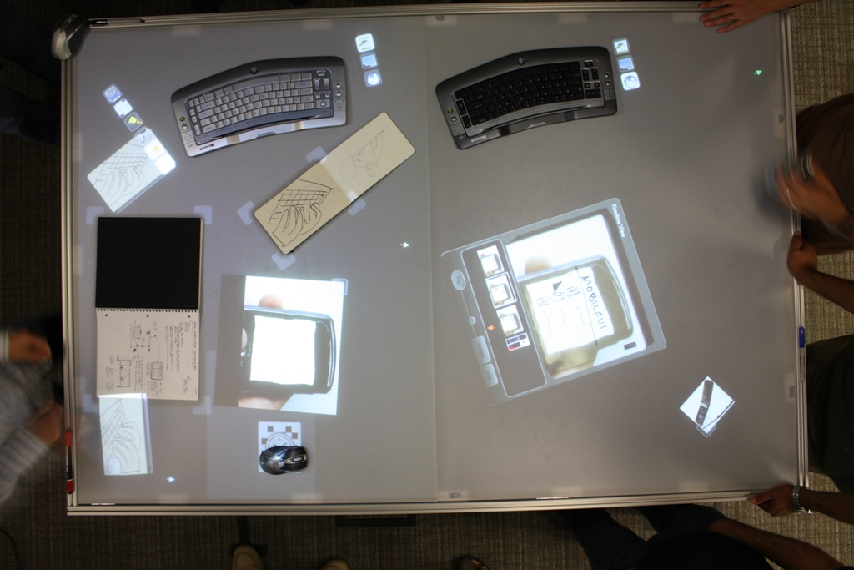
View From the Top (4272x2848 pixels, 60dpi)

Slide 10
Software
Surface SDK (slightly modified)
1024x1536 pixels (21.3 dpi)
Vision code (combines 2 cameras)
Fingers + Blobs @ 30Hz
640x960 pixels (13.3 dpi)
Location, Orientation, Major/minor axes
Canon EDSDK for still image capture
Runs any Surface application

Slide 11
Video: Capture + Annotate

Slide 12
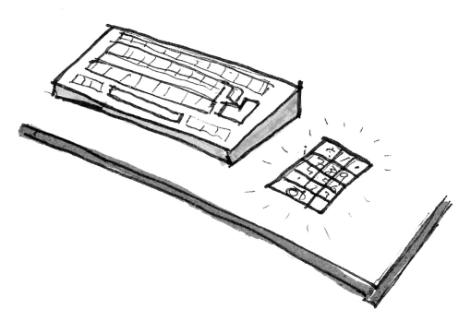
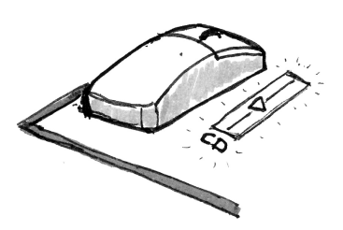
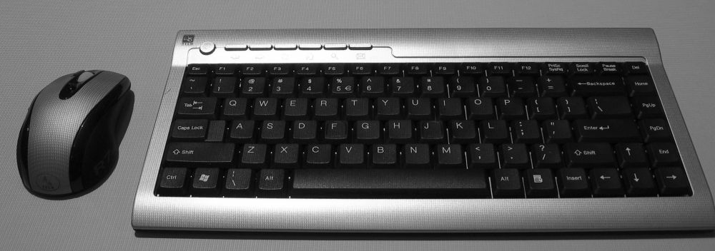
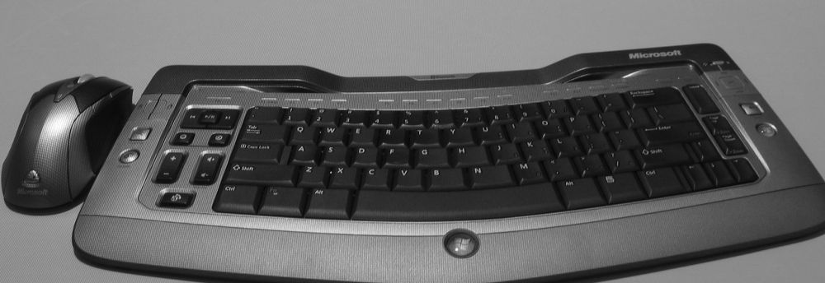
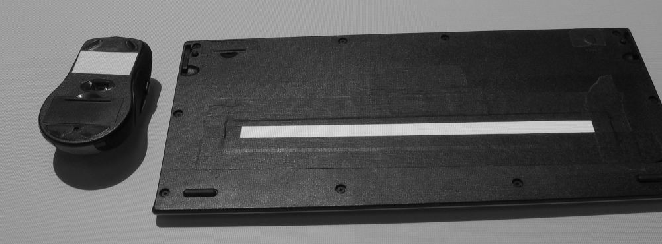
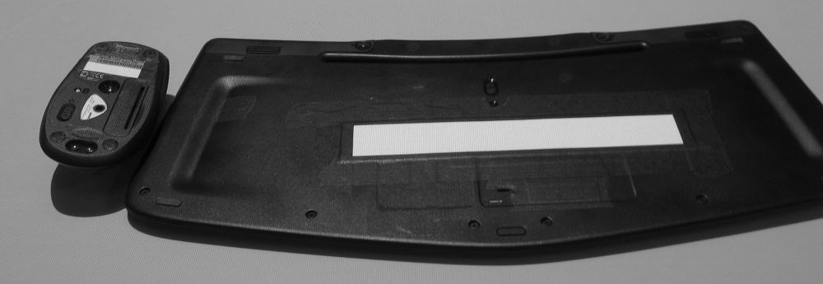
Supporting Multiple Input Devices
Device-referenced display
Context-sensitive device configuration

Slide 13
Video: Keyboard + Search

Slide 14
Video: Mice

Slide 15
Video: Croupier-Style Interactions

Slide 16
Video: Rapid Prototyping Scenario

Slide 17
Video: Session Record from the Top

Slide 18
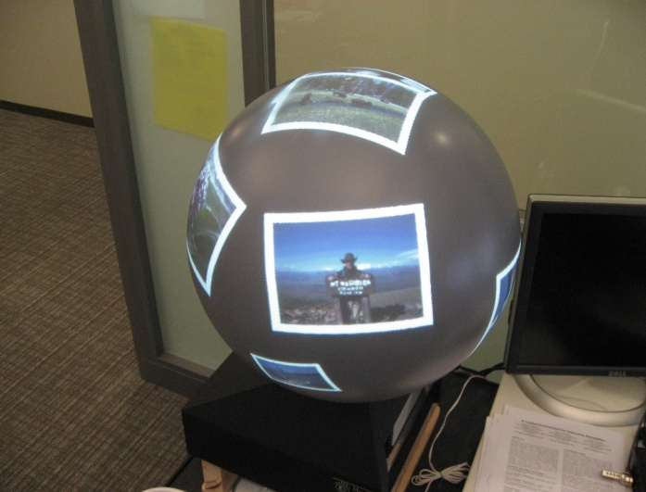
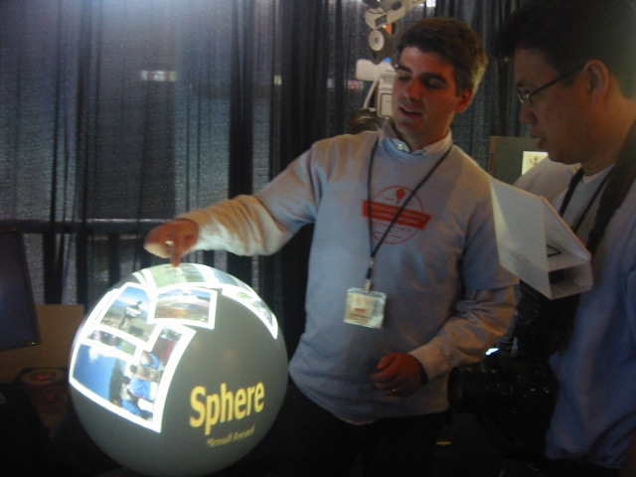
Interacting on Curved Surfaces
Projects:
Sphere
Dome
Enabling the projection and interaction on a curved omni-directional display

Slide 19
Video: Sphere

Slide 20
Sphere Video

Slide 23
Reusing the Optical Path

Slide 24
Video: Touch-Sensing

Slide 25
Touch-Sensing Software Pipeline

Slide 26
Video: Projection Distortions

Slide 27
Projection Distortions

Slide 28
Video: Sphere Interactions

Slide 29
Sphere Multi-Touch Interactions

Slide 30
Sphere Paint & Pong

Slide 31
Video: MiniSphere

Slide 34
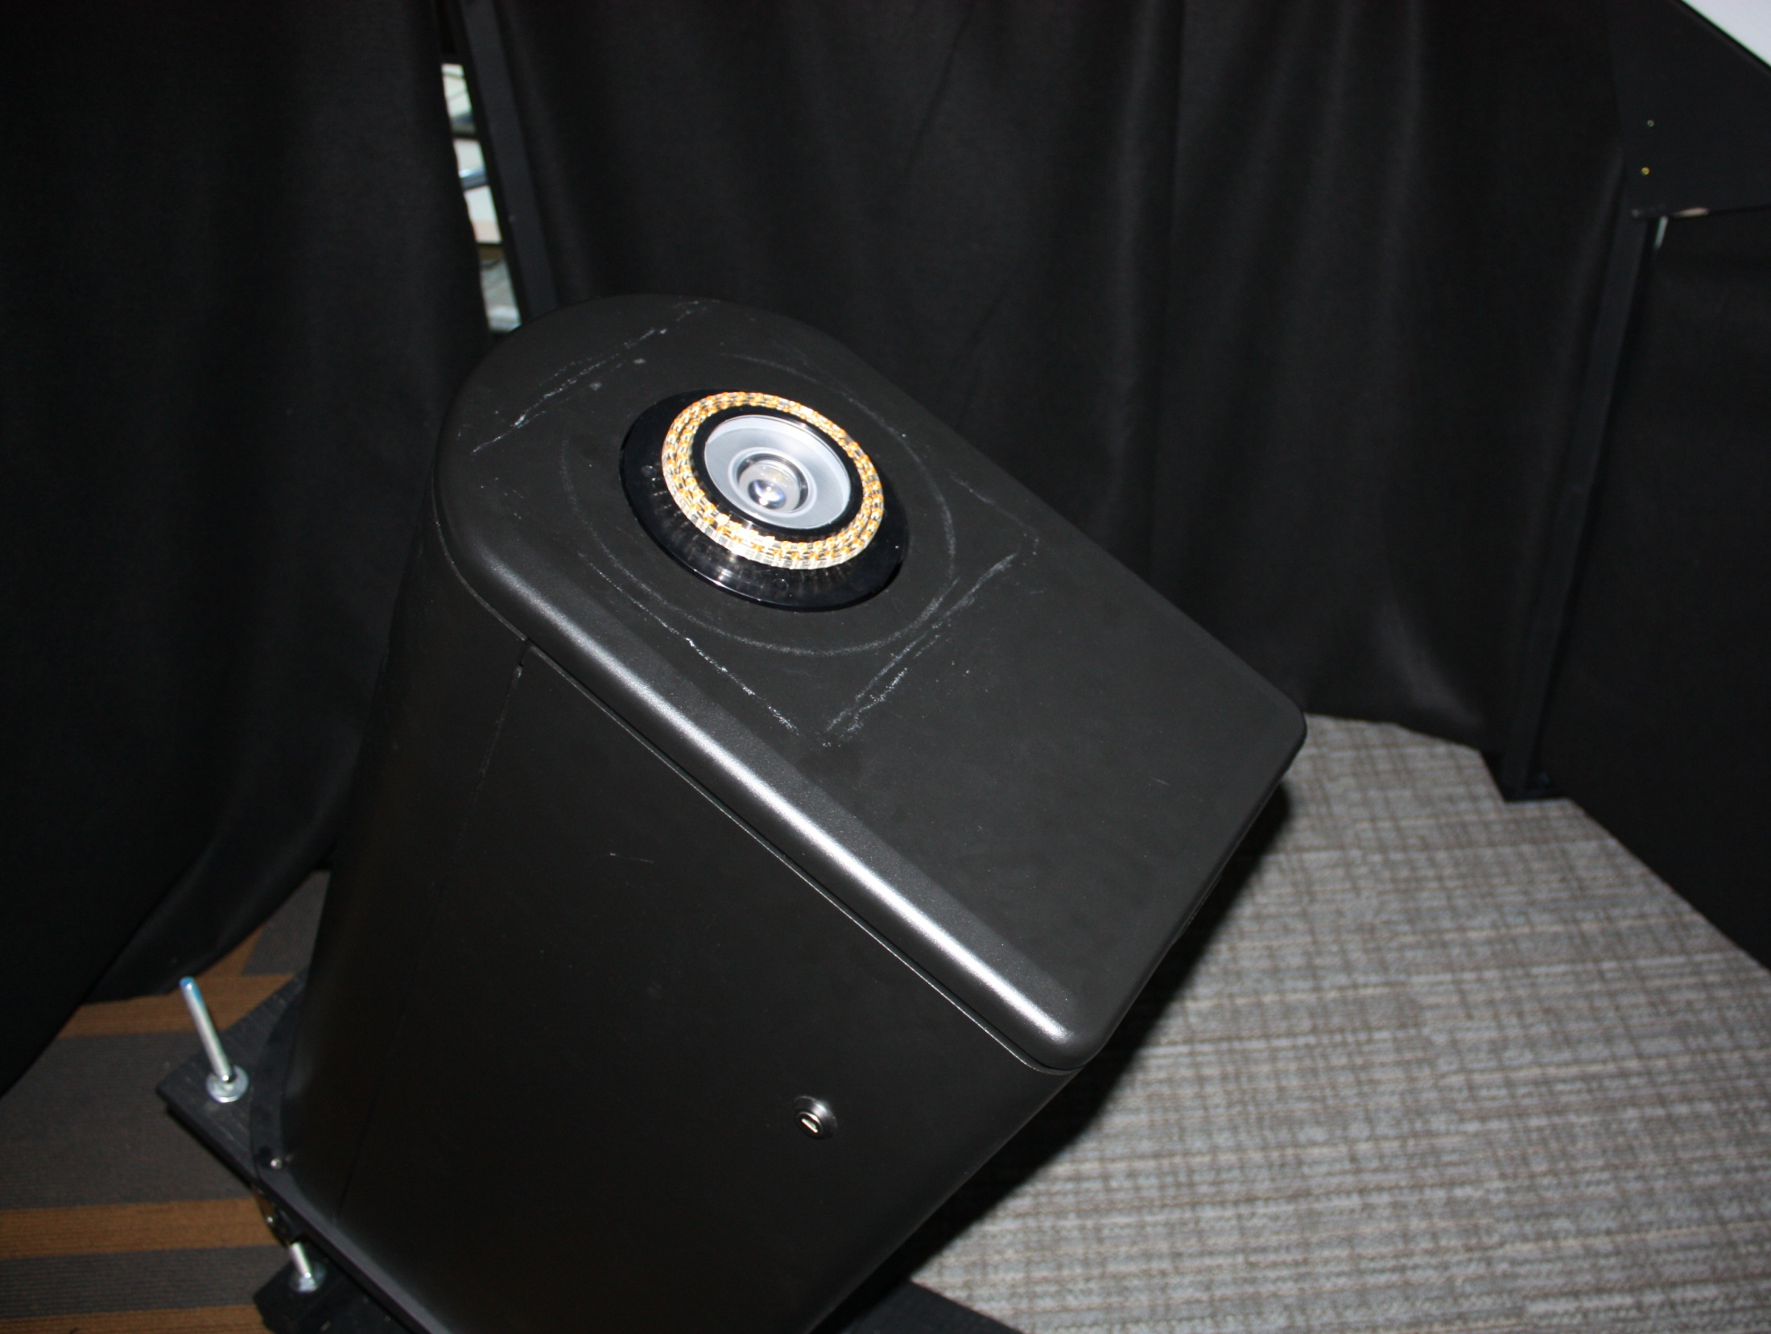

Slide 35
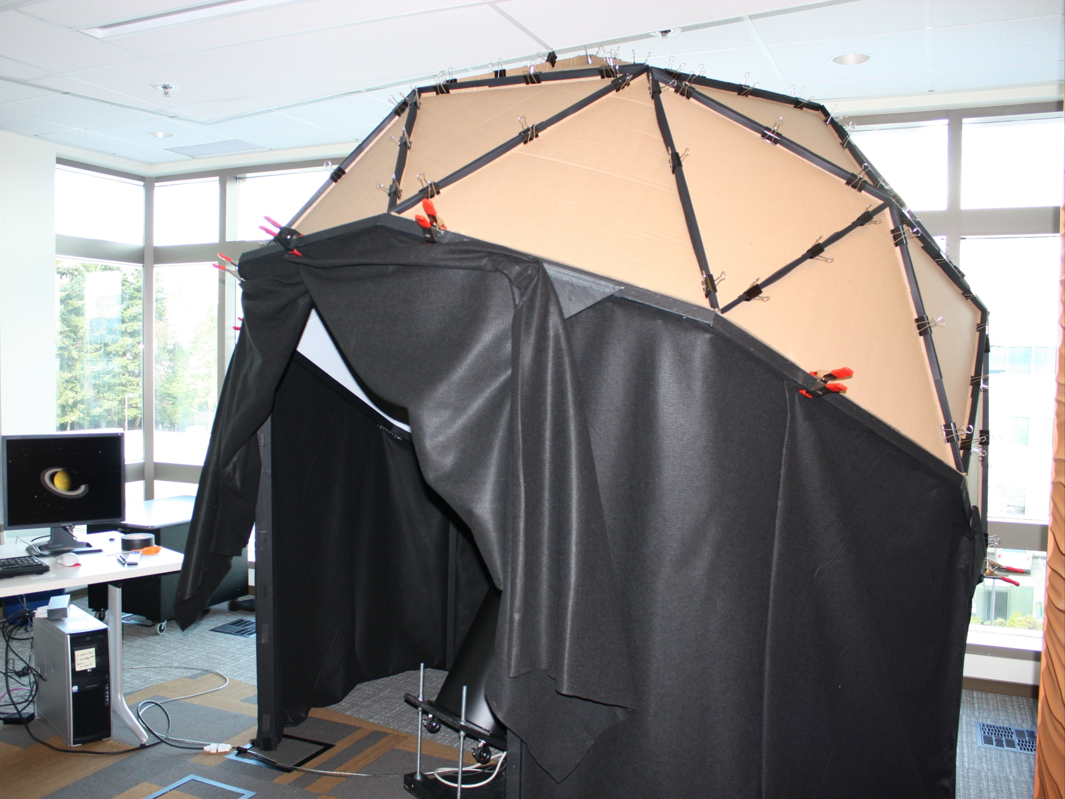

Slide 36
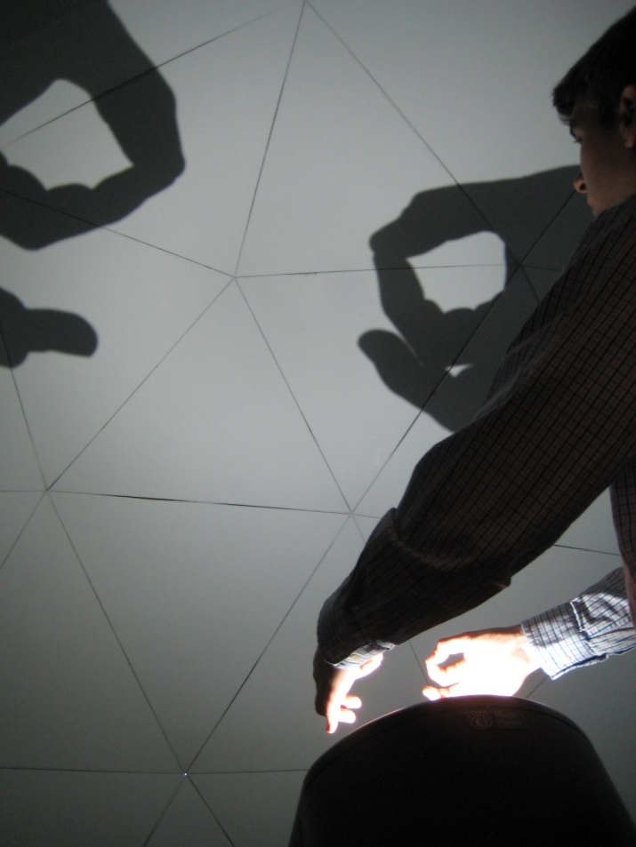
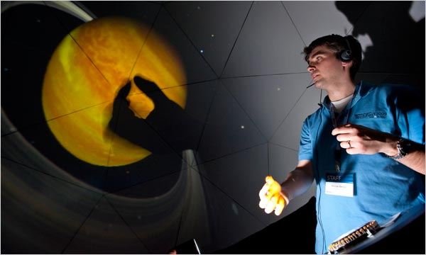
“Pinch the Sky” Dome
OmniDirectional Content:
WorldWideTelescope
RoundTable 360 deg. camera
3D social network graph
TechFest video
© New York Times 3/2/09

Slide 37
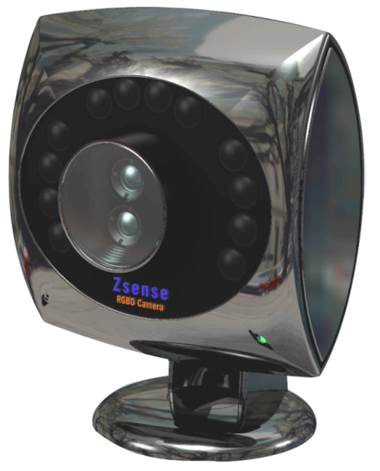
Above-the-surface Interaction
New cameras give depth map + color: RGBZ
Improves understanding of physical objects on surface
Can compute ‘world coordinates’ directly
Infrared camera + GaAs solid state shutter
Pulsed infrared lasers
RGB camera

Slide 38
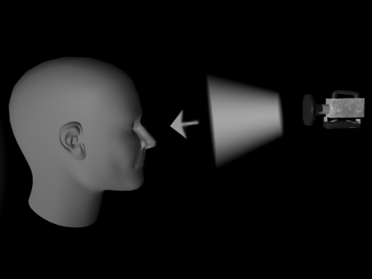
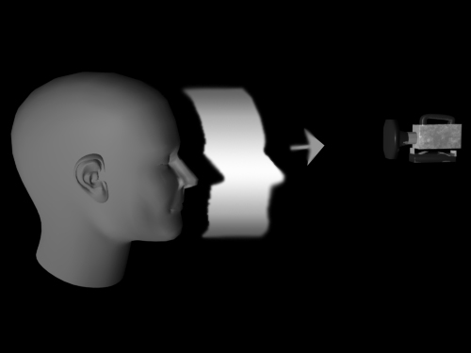
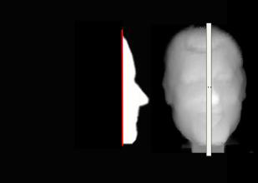
Example: time of flight (3DV)

Slide 39
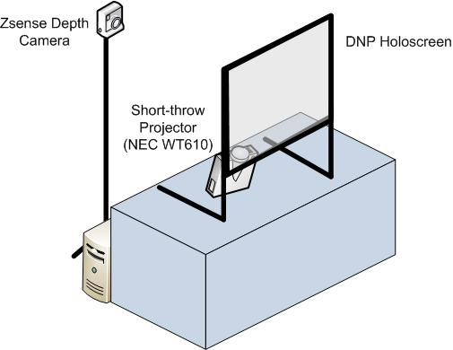
DepthTouch Hardware Setup

Slide 40
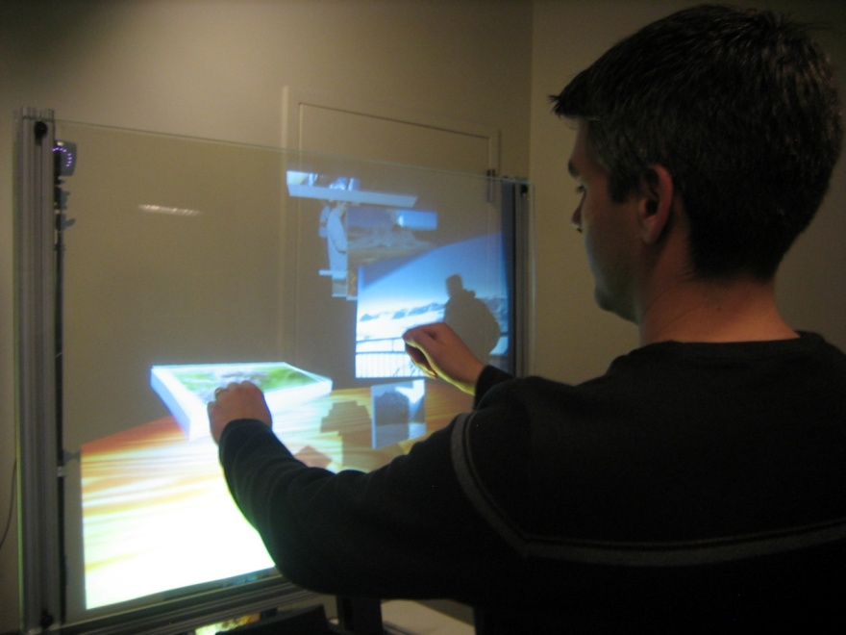
Above-the-surface Videos
DepthTouch
pptPlex
BeachBall
MicroMotoCross

Slide 41
Cursors considered harmful
Multi-touch systems are still typically rooted in the “standard cursor model”
In processing
Interactions

Slide 42
Cursors considered harmful
Pulling out discrete contact points is an ill-posed problem
Leads to all sorts of mayhem!
1
2
1 or 2 ?
3
3

Slide 43
Shape and Physics Interactions
ShapeTouch
SurfacePhysics

Slide 44
Contact
Andy Wilson
awilson@microsoft.com
http://research.microsoft.com/~awilson
Hrvoje Benko
benko@microsoft.com
http://research.microsoft.com/~benko

